Slide 1
Kubernetes – Introduction
29-Aug-2018

Slide 2

Noticeable Challenges and Trends
AGENDA
01
What is Kubernetes
02
Why Kubernetes
03
Kubernetes Architecture
04
Kubernetes Objects
04
05
Basic Examples
08
Q & A
06

Slide 3
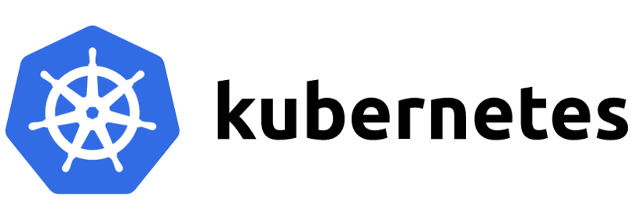
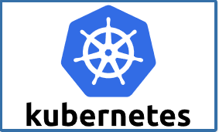


Slide 4
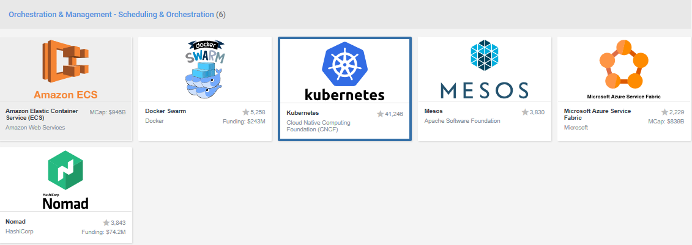

Slide 5
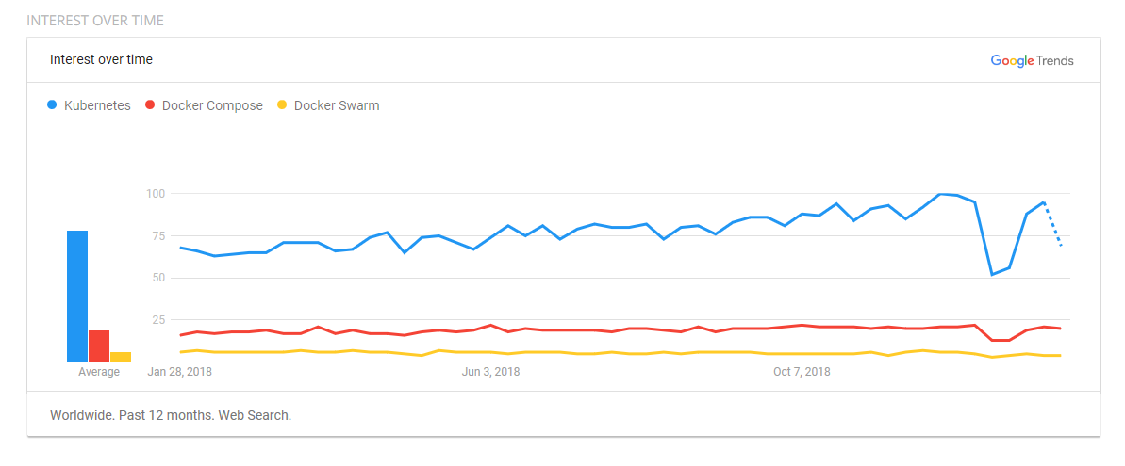
Trends Comparison

Slide 6
WHAT IS KUBERNETES
"Kubernetes is an open-source system for automating deployment, scaling, and management of containerized applications.“
Kubernetes comes from the Greek word κυβερνήτης meaning helmsman or ship pilot.
Kubernetes is also referred to as k8s, as there are 8 characters between k and s.
Kubernetes is highly inspired by the Google Borg system.
It is an open source project written in the Go language, and licensed under the Apache License Version 2.0.
Kubernetes was started by Google and, with its v1.0 release in July 2015, Google donated it to the Cloud Native Computing Foundation (CNCF).
Generally, Kubernetes has new releases every three months. The current stable version is 1.9 (as of February 2018).

Slide 7
KUBERNETES ADVANTAGES
Usage of proven Architectural concepts used at Google for more than a decade
Pods / Pod Orchestration
Internal Routing
External Routing
Service Discovery
Pod Rollouts, Rollbacks
Config Maps
Secrets
Self Healing
Auto scale Pods and Container Cluster
Batch Execution
Storage Orchestration
Works very similar to VM based deployments
Orchestration, routing, load balancing etc.
Run anywhere
Kubernetes is infrastructure independent
Run on private, public and hybrid clouds
Easier to manage containers compared to VMs:
Layered container images
Less content transferred in the wire
Container image repositories
Large Developer community
High Industry adaption

Slide 8
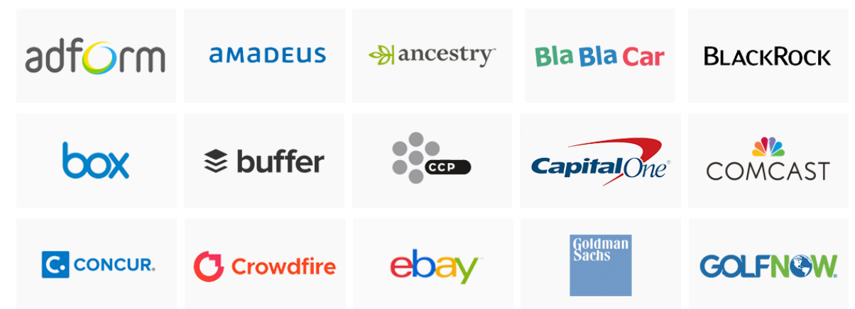
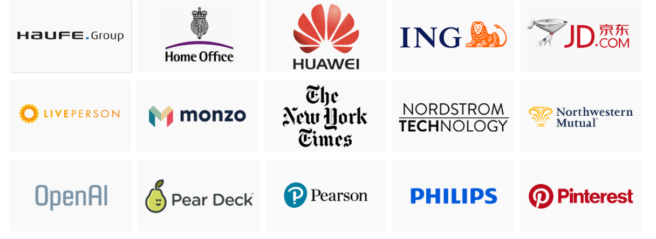
KUBERNETES USERS

Slide 9
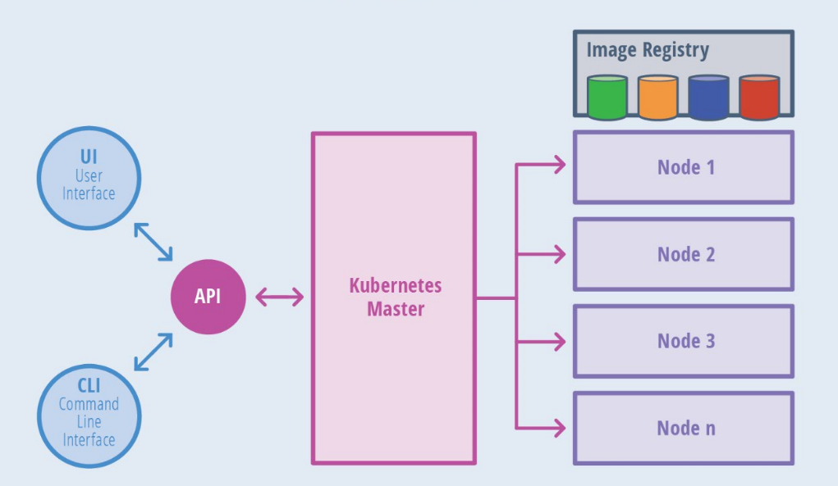
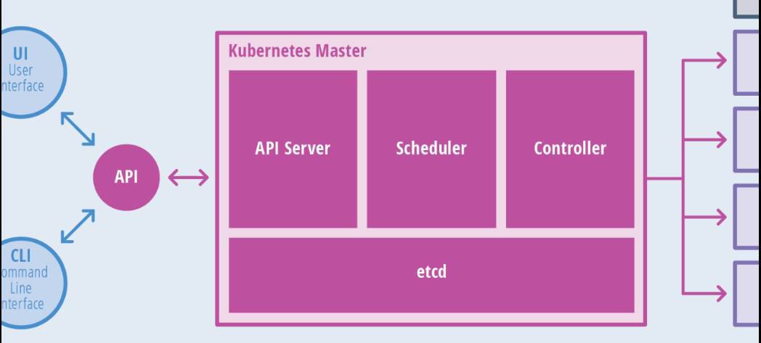
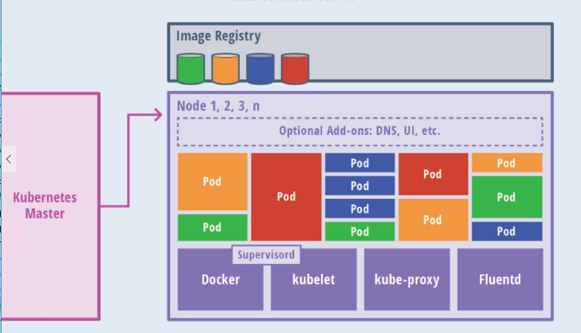
KUBERNETES ARCHITECTURE

Slide 10
KUBERNETES ARCHITECTURE
The master node is responsible for managing the Kubernetes cluster, and it is the entry point for all administrative tasks. For fault tolerance purposes, there can be more than one master node in the cluster i.e. High Availability Mode (Leader/Follower)
Master Node components
Kube-apiserver – User/Operator send REST commands to the API Server which validates and processes the requests.
kube-scheduler - watches newly created pods that have no node assigned, and selects a node for them to run on.
etcd - Consistent and highly-available key value store used as Kubernetes’ backing store for all cluster data
kube-controller-manager - manages different non-terminating control loops, which regulate the state of the Kubernetes cluster
Node Controller: Responsible for noticing and responding when nodes go down.
Replication Controller: Responsible for maintaining the correct number of pods for every replication controller object in the system.
Endpoints Controller: Populates the Endpoints object (that is, joins Services & Pods).
Service Account & Token Controllers: Create default accounts and API access tokens for new namespaces.
Cloud-controller-manager – controllers that interact with cloud providers

Slide 11
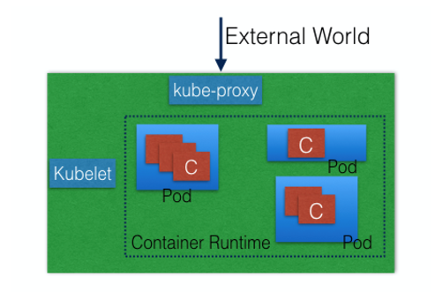
KUBERNETES ARCHITECTURE
Node Components
Node components run on every node, maintaining running pods and providing the Kubernetes runtime environment.
kubelet
An agent that runs on each node in the cluster. It makes sure that containers are running in a pod.
The kubelet connects to the container runtime using Container Runtime Interface (CRI).
kube-proxy
It enables the Kubernetes service abstraction by maintaining network rules on the host and performing connection forwarding.
Container Runtime
The container runtime is the software that is responsible for running containers. Kubernetes supports several runtimes : Docker, rkt, runc.

Slide 12
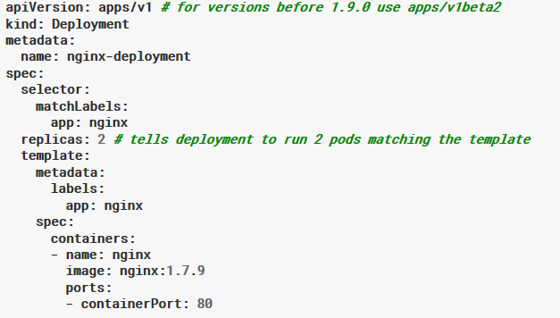
UNDERSTANDING KUBE RESOURCES
Kubernetes Objects are persistent entities in the Kubernetes system
A Kubernetes object is a “record of intent”– By creating an object, you’re effectively telling the Kubernetes system what you want your cluster’s workload to look like; this is your cluster’s desired state.
Kubectl – CLI to interact with Kube API.
Object Spec and Object Status
Spec -- describes your desired state for the object
Status – describes the actual state of the object
Information is provided to kubectl in .yaml file which is
converted to JSON while making the API request
Required fields
apiVersion
kind
metadata

Slide 13
UNDERSTANDING KUBE RESOURCES
Container Orchestration
Pods
Replica Sets
Deployments
Internal Routing
Services
External Routing
Ingresses & Ingress Controllers
Configuration Management
Config Maps
Credentials Management
Secrets
Persistent Volumes
Rolling Out Updates
Autoscaling
Horizontal Pod Autoscalers

Slide 14
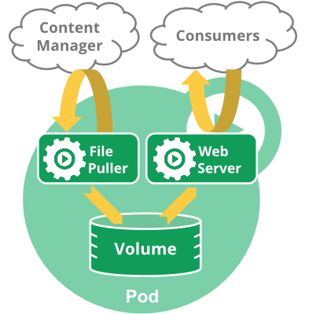
UNDERSTANDING KUBE RESOURCES
Pods
A Pod is the smallest and simplest Kubernetes object. It is the unit of deployment in Kubernetes, which represents a single instance of the application. A Pod is a logical collection of one or more containers.
Pods are ephemeral in nature
Each Pod is assigned a unique IP address
Share the same network namespace (Including IP address,Ports)
Mount the same external storage (volumes).
Containers inside Pod can communicate with each other using localhost
Controller can create and manage multiple Pods for you, handling
replication and rollout and providing self-healing capabilities at
cluster scope

Slide 15
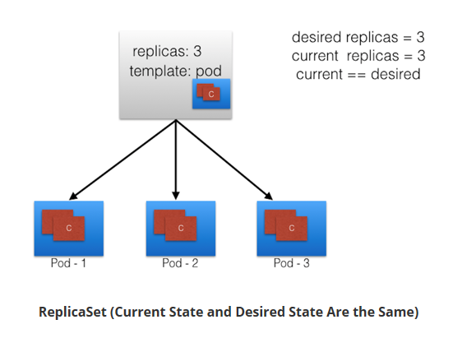
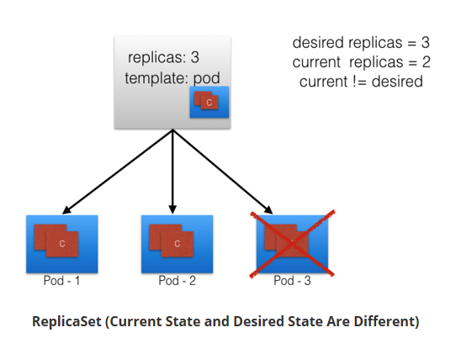
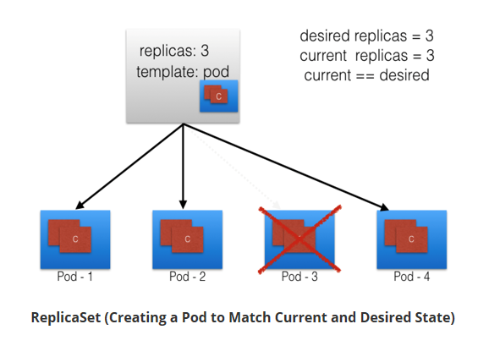
UNDERSTANDING KUBE RESOURCES
ReplicaSets
Next-generation ReplicationController.
It’s mainly used by Deployment as a mechanism to orchestrate pod creation, deletion and updates.
ReplicaSets support both equality- and set-based selectors, whereas ReplicationControllers only support equality-based Selectors.
A Deployment automatically creates the ReplicaSets, and we do not have to worry about managing them.

Slide 16
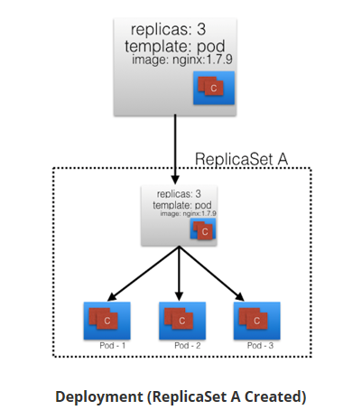
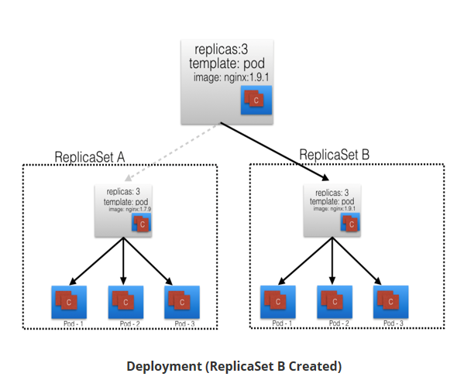
UNDERSTANDING KUBE RESOURCES
Deployments
Provides declarative updates to Pods and ReplicaSets.
The DeploymentController is part of the master node's controller manager, and it makes sure that the current state always matches the desired state.
In the following example, we have a Deployment which creates a ReplicaSet A. ReplicaSet A then creates 3 Pods. In each Pod, one of the containers uses the nginx:1.7.9 image.

Slide 17
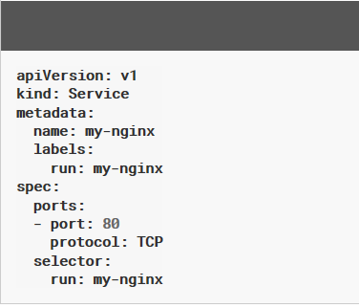
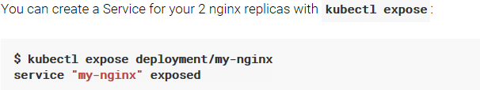
Services
Service is an abstraction which defines a logical set of Pods running somewhere in your cluster, that all provide the same functionality.
Each Service is assigned a unique IP address (also called clusterIP).
This address is tied to the lifespan of the Service, and will not change while the Service is alive.
Pods can be configured to talk to the Service, and know that communication to the Service will be automatically load-balanced out to some pod that is a member of the Service.

Slide 18
Service Discovery
Service discovery is the process of figuring out how to connect to a service.
While there is a service discovery option based on environment variables available, the DNS-based service discovery is preferable.

Slide 19
UNDERSTANDING KUBE OBJECTS
StatefulSet is the workload API object used to manage stateful applications.
A DaemonSet ensures that all (or some) Nodes run a copy of a Pod. As nodes are added to the cluster, Pods are added to them. As nodes are removed from the cluster, those Pods are garbage collected. Deleting a DaemonSet will clean up the Pods it created.
Namespaces are a way to divide cluster resources between multiple users. Namespaces provide a scope for names. Names of resources need to be unique within a namespace, but not across namespaces.
Via a label selector, the client/user can identify a set of objects. The label selector is the core grouping primitive in Kubernetes.
Annotations - we can attach arbitrary non-identifying metadata to any objects, in a key-value format:
"annotations": { "key1" : "value1", "key2" : "value2"

Slide 20
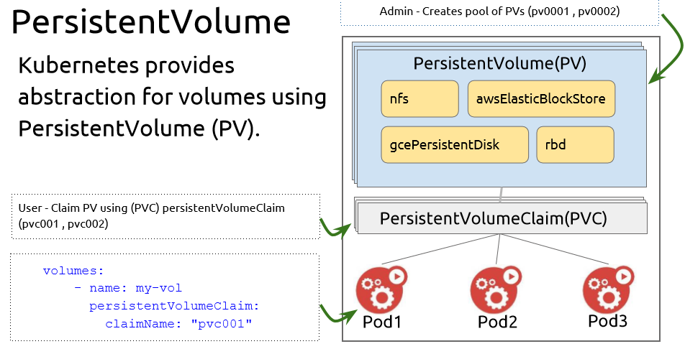
UNDERSTANDING KUBE RESOURCES

Slide 21
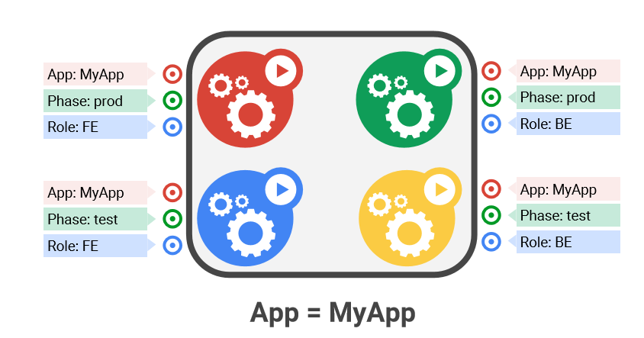
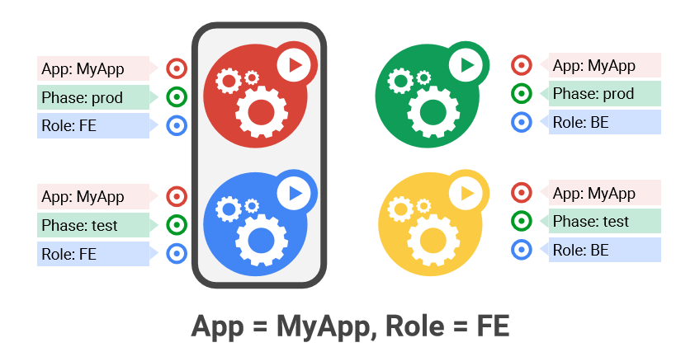
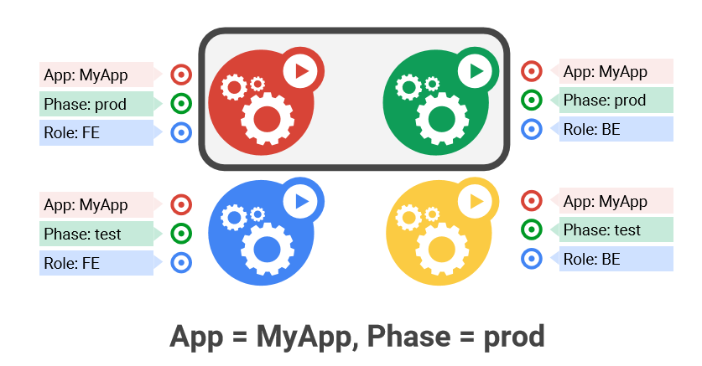
UNDERSTANDING KUBE RESOURCES
Labels
Label are attached to pods ,
services , rc or almost any
other objects in k8s
Can be used to organize or
select subset of object.
Queryable by selectors like SQL ‘select ... where ...’
The only grouping mechanism
pods under a ReplicationController
pods in a Service
capabilities of a node (constraints)

Slide 22
UNDERSTANDING KUBE RESOURCES
Volumes (Pod Scoped Storage)
Support many types of volume plugins
Empty dir (and tmpfs)
Host path
Git repository
GCE Persistent Disk
AWS Elastic Block Store
Azure File Storage
iSCSI
Flocker
NFS
vSphere
GlusterFS
Ceph File and RBD
Cinder
FibreChannel
Secret, ConfigMap, DownwardAPI
Flex (exec a binary

Slide 23
MINIKUBE
What is Minikube?
Minikube was developed to allow users to run Kubernetes locally. When you install and run Minikube on your computer, it runs a single-node Kubernetes cluster inside a virtual machine.
Why Minikube?
Minikube is intended for both new users and regular developers. Installing Kubernetes is time-consuming and resource-intensive. With Minikube, you get a smaller working version of a single-node Kubernetes cluster on your personal computer.
It gives you the ability to play around and understand the basic concepts. Once you become regular practitioner you can still use Minikube to test out your ideas locally before you deploy it in your data center or server. It can work as your test environment.
What Can You Do With Minikube?
Minikube is great for learning Kubernetes and testing your concepts and ideas during development.

Slide 24
MINIKUBE
Minikube/Kubernetes Concepts
Container – used as the building blocks of creating applications.
Pod – Pod is a collection of one or more containers that share storage and network resources. Pods contain the definition of how the containers should be run in Minikube. Minikube uses these definitions to maintain the necessary resources. For example, you can define you need two pods. During execution, if a pod goes down,
Minikube will automatically fire up a new pod.
Service – Because pods are replaceable, Minikube needs an abstraction layer to keep the interaction between the different pods seamless. For example, if a pod dies and a new pod is created, the application users shouldn’t get bogged down in the details of network addresses and related issues. Services are wrappers around the pods to create levels of abstraction.
Master – Master coordinates the cluster. It’s like the brains of the operation.
Node – Workers who run the pods.
kubectl – It’s the command line interface for running commands on Kubernetes cluster.

Slide 25
MINIKUBE INSTALLATION
Your hardware needs have virtualization enabled in your computer’s BIOS. The good news is most modern machine already has this turned on.
Here are the steps to install Minkube on your machine:
Install VirtualBox
Install kubectl
Install Minikube
https://kubernetes.io/docs/tasks/tools/install-minikube/
https://github.com/kubernetes/minikube/releases
https://kubernetes.io/docs/setup/minikube/
Simple Example of Deploying on Minikube
Once you have everything installed, you can start Minikube with the following command:

Slide 26
MINIKUBE
$ minikube start
There is a newer version of minikube available (v0.28.0). Download it here: https://github.com/kubernetes/minikube/releases/tag/v0.28.0 To disable this notification, run the following: minikube config set WantUpdateNotification false
Starting local Kubernetes v1.9.0 cluster... Starting VM... Getting VM IP address... Moving files into cluster... Setting up certs... Connecting to cluster... Setting up kubeconfig... Starting cluster components... Kubectl is now configured to use the cluster. Loading cached images from config file.

Slide 27
MINIKUBE
You can use the following command to check your Minikube status:
$ minikube status minikube: Running cluster: Running kubectl: Correctly Configured: pointing to minikube-vm at 192.168.99.100
Using Minikube we can see everything that is going on in Minikube. You can also control resources in your cluster from the dashboard. Use the following command to start up the dashboard in your default browser:
$ minikube dashboard
Opening kubernetes dashboard in default browser...
Here is how the dashboard should look:
$ Minikube stop
Stopping local Kubernetes cluster... Machine stopped.

Slide 28
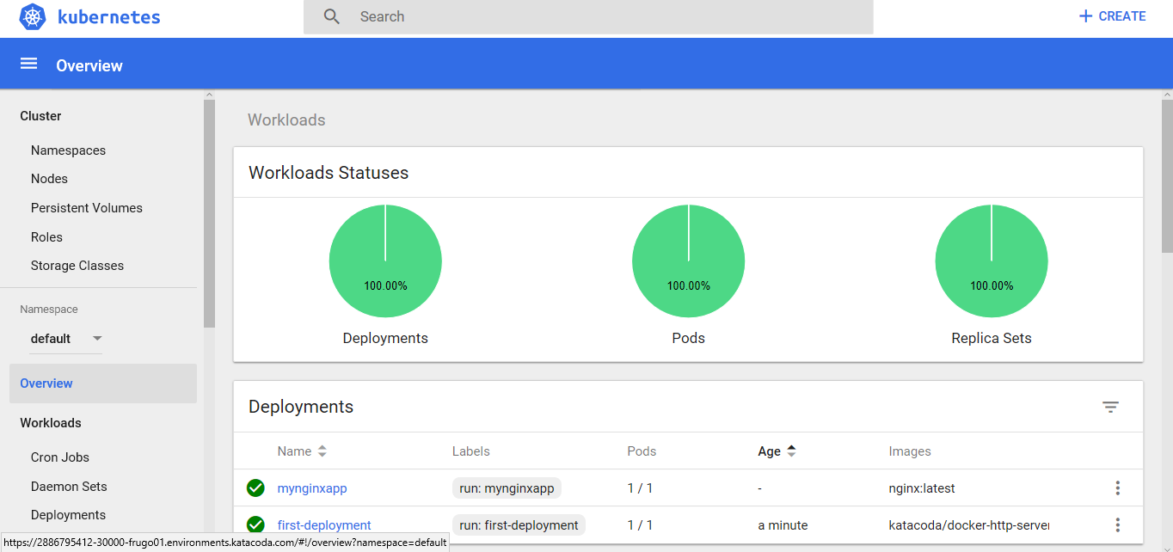
MINIKUBE DASHBOARD

Slide 29
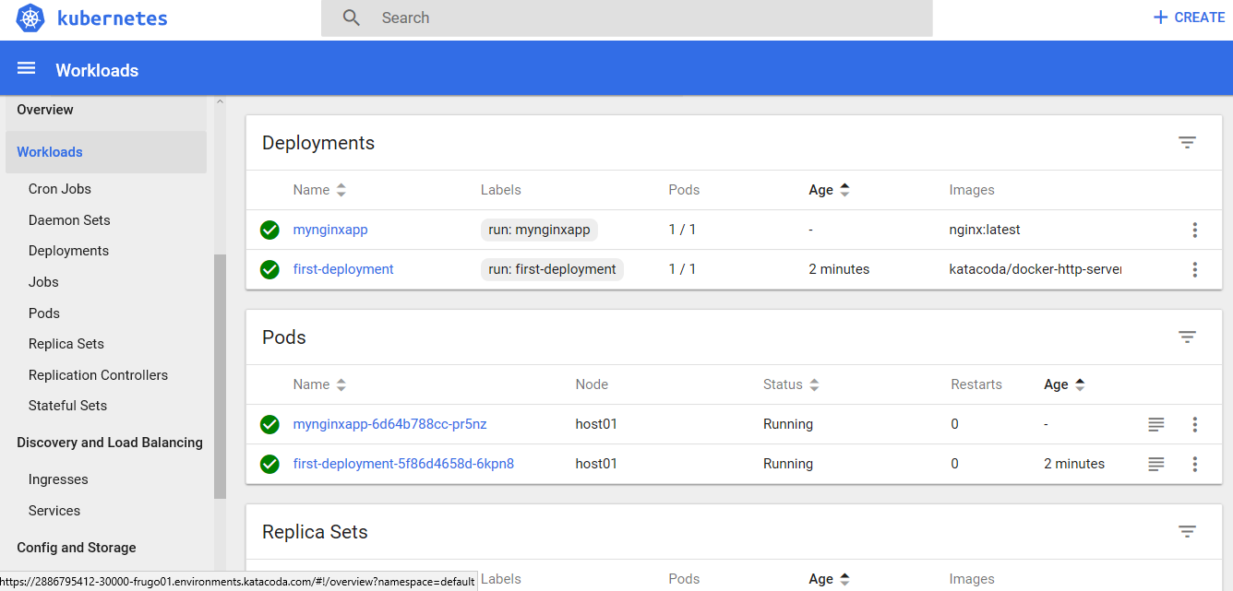
MINIKUBE DASHBOARD

Slide 30
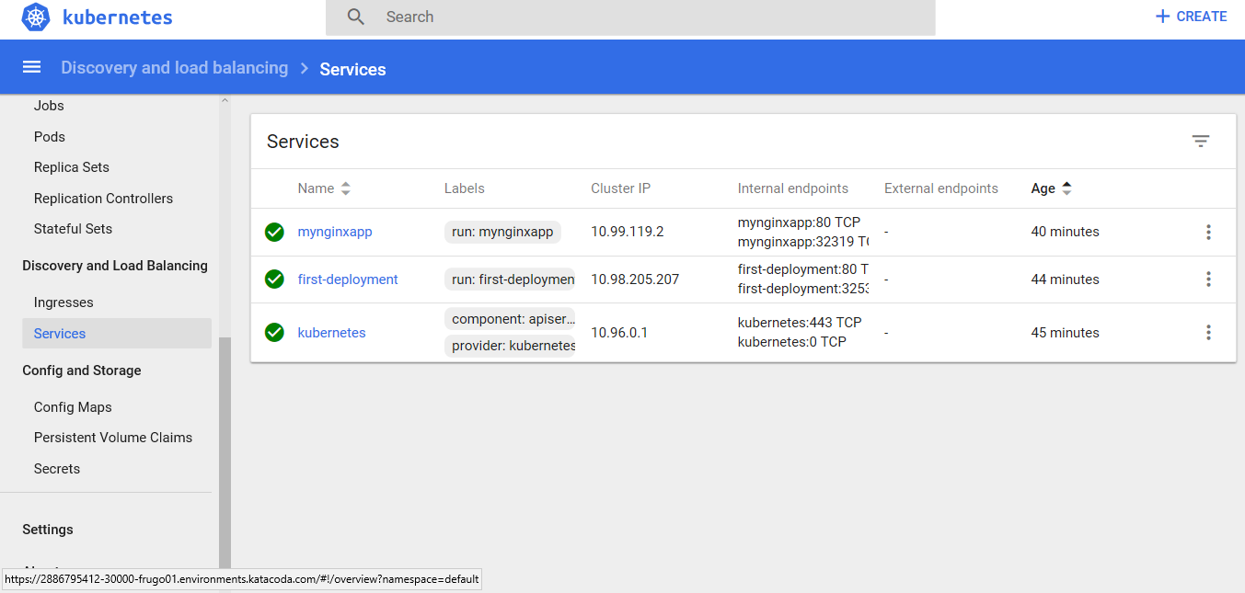
MINIKUBE DASHBOARD

Slide 31
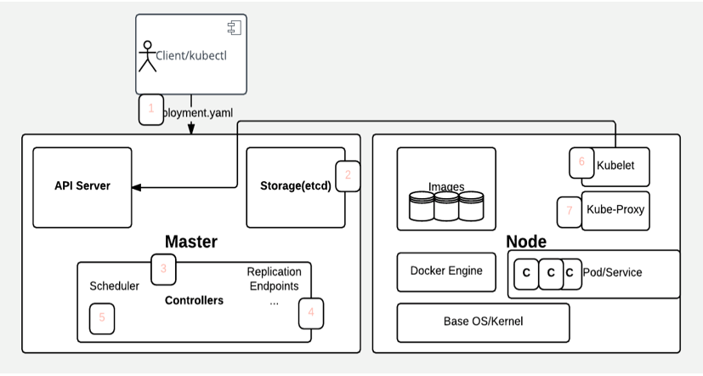
K8 APP DEPLOYMENT WORKFLOW

Slide 32
K8 APP DEPLOYMENT WORKFLOW
The user deploys a new app by using the kubectl CLI. Kubectl sends the request to the API server.
The API server receives the request and stores it in the data store (etcd). After the request is written to the data store, the API server is done with the request.
Watchers detect the resource changes and send notifications to the Controller to act on those changes.
The Controller detects the new app and creates new pods to match the desired number of instances. Any changes to the stored model will be used to create or delete pods.
The Scheduler assigns new pods to a node based on specific criteria. The Scheduler decides on whether to run pods on specific nodes in the cluster. The Scheduler modifies the model with the node information.
A Kubelet on a node detects a pod with an assignment to itself and deploys the requested containers through the container runtime, for example, Docker. Each node watches the storage to see what pods it is assigned to run. The node takes necessary actions on the resources assigned to it such as to create or delete pods.
Kubeproxy manages network traffic for the pods, including service discovery and load balancing. Kubeproxy is responsible for communication between pods that want to interact.

Slide 33
References :
https://kubernetes.io/docs/tutorials/kubernetes-basics/
https://courses.edx.org/courses/course-v1:LinuxFoundationX+LFS158x+1T2018/course/

Slide 35


Slide 36
$7 BILLION | 110,000 EMPLOYEES | 31 COUNTRIES

